Slide 1
Numerical Optimization and its Applications in Protein Folding
Breindy Berger

Slide 2
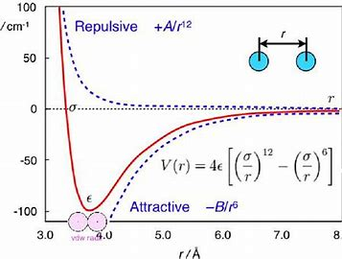
Goal: Predict how proteins will fold by minimizing potential energy between atoms.
Image: https://www.semanticscholar.org/paper/The-Lennard-Jones-Potential-Minimization-Problem-Zhang/3fb051c2572f7744d303ddc653de9b2728c557b3

Slide 3
Nelder Mead Method:
Form simplex
Organize points from best to worst
Calculate centroid and reflect
Expand, contract, and shrink
Repeat until convergence or too many iterations

Slide 4
Gradient Descent Method:
Calculate Gradient
Move in the opposite direction
Repeat until convergence or too many iterations
* Optional: Backtrack–adjust step size at every iteration

Slide 5
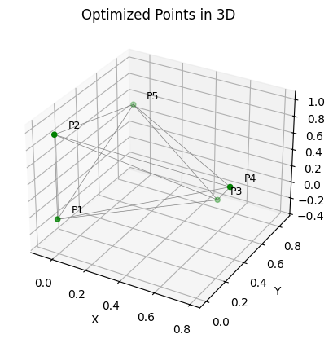
Configuration of 5 atoms: Nelder-Mead
Final simplex vertices:
[[ 0. 0. 0. ]
[ 0. 0. 0.99790742]
[ 0.48366475 0.80890788 -0.3280262 ]
[ 0.79256109 0.34966669 0.50235512]
[-0.06680203 0.8636952 0.50250333]]
Function values at vertices:
[-9.10385166 -9.10385146 -9.10385141 -9.10385131 -9.10385129 -9.10385116
-9.10385108 -9.10385092 -9.10385073 -9.1038507 -9.10385067]
potential energy at minimum: -9.103851658864423
Number of steps: 1565

Slide 6
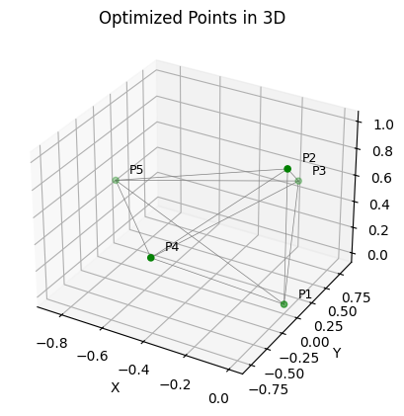
Configuration of 5 atoms: Gradient Descent
Initial energy: 45.35161913489518
Initial gradient norm: 1386.9785364813197
Final simplex vertices:
[ 1.00147347 -0.17548036 0.84515064 0.50074512 -0.39725335 -0.7663307
0.50074512 -0.85917177 0.11823972 0.50074635]
Potential energy at minimum: -9.10385238706892
Number of steps: 5689
Norm of gradient: 0.0009934737314662983

Slide 7
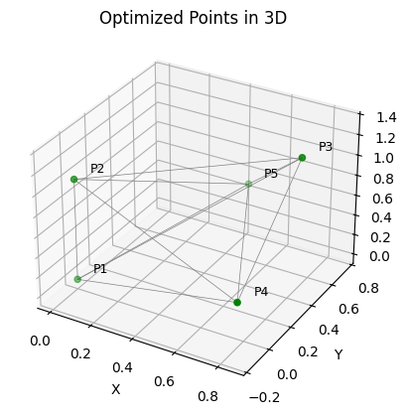
Configuration of 5 atoms: Gradient Descent BT
Final simplex vertices:
[ 0.99790033 0.85599402 0.39445944 1.32577648 0.8515571 -0.15890101
0.49537118 0.43240181 0.750617 0.49539349]
Potential energy at minimum: -9.103852397746724
Number of steps: 176
Norm of gradient: 0.0007803869611007267

Slide 8
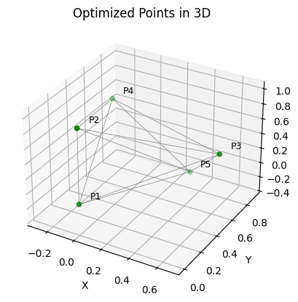
Configuration of 6 atoms: Nelder-Mead
Final simplex vertices:
[[ 0. 0. 0. ]
[ 0. 0. 0.99797151]
[ 0.68099272 0.53542583 0.50258224]
[-0.27916685 0.82000813 0.50268793]
[ 0.26781238 0.90369963 -0.32774348]]
Function values at vertices:
[-9.10385172 -9.1038515 -9.10385129 -9.10385126 -9.1038512 -9.10385114
-9.10385114 -9.10385111 -9.10385087 -9.10385086 -9.10385084]
potential energy at minimum: -9.103851721282108
Number of steps: 551

Slide 9
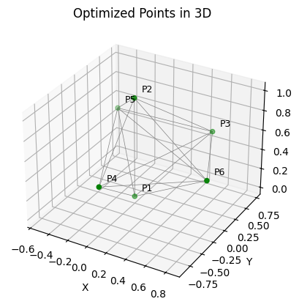
Configuration of 6 atoms: Gradient Descent
Initial energy: 44.07103459057907
Initial gradient norm: 1386.98091793431
Final simplex vertices:
[ 1.00805282 0.46965962 0.72228089 0.50402165 0.07658453 -0.85429192
0.50402204 -0.5287991 0.67531576 0.50402204 0.83674888 -0.20523437
0.50402165]
Potential energy at minimum: -12.302927476873355
Number of steps: 5298
Norm of gradient: 0.000996777021810333

Slide 10
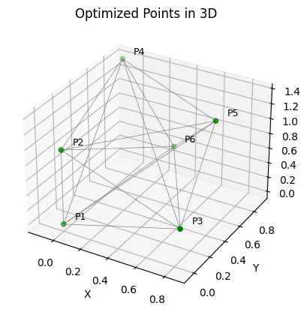
Configuration of 6 atoms: Gradient Descent BT
Final simplex vertices:
[ 0.99485398 0.86473631 -0.05011962 0.49883758 -0.11544831 0.91812616
1.36013405 0.79473431 0.50659699 1.32358357 0.34095558 0.7994337
0.48415393]
Potential energy at minimum: -12.302927453761779
Number of steps: 218
Norm of gradient: 0.000982183786030248

Slide 11
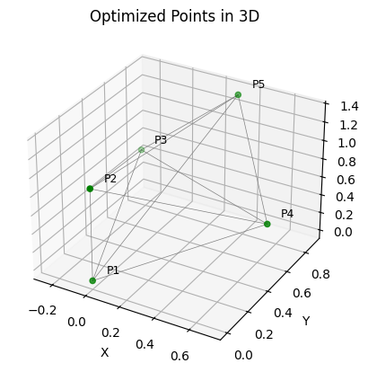
Configuration of 10 atoms: Nelder-Mead
Final simplex vertices:
[[ 0. 0. 0. ]
[ 0. 0. 0.99790427]
[-0.24204857 0.83175926 0.49551786]
[ 0.70430377 0.5044323 0.49535364]
[ 0.3082655 0.89037868 1.32606686]]
Function values at vertices:
[-9.10384992 -9.10384982 -9.10384974 -9.10384962 -9.10384932 -9.10384924
-9.1038492 -9.10384911 -9.10384902 -9.10384899 -9.10384893]
potential energy at minimum: -9.103849923273563
Number of steps: 1413

Slide 12
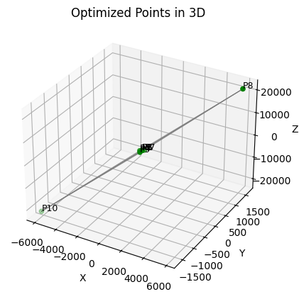
Configuration of 10 atoms: Gradient Descent
Initial energy: 619020.6122258276
Initial gradient norm: 31232477.39639582
Final simplex vertices:
[ 1.00147353e+00 5.18884281e-01 6.94921439e-01 5.00746401e-01
-1.44089676e+02 -3.54458731e+01 -1.66265790e+01 -4.78757882e-01
7.18236599e-01 5.00745172e-01 8.24651997e-01 -2.54994129e-01
5.00745172e-01 1.44943370e+02 3.41855675e+01 1.53095303e+01
5.84100222e+03 1.62374968e+03 2.12211149e+04 1.32086080e+01
-1.01756207e+02 6.93465067e+01 -5.88836399e+03 -1.62243004e+03
-2.12374147e+04]
Potential energy at minimum: -9.103852386929766
Number of steps: 2636
Norm of gradient: 0.0009959644041579977

Slide 13
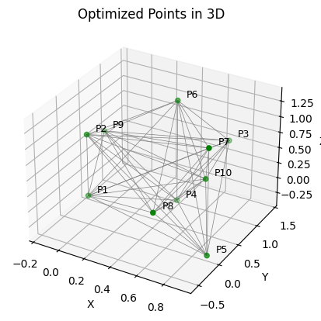
Configuration of 10 atoms: Gradient Descent BT
Final simplex vertices:
[ 0.9888312 0.65856591 1.40421426 0.49434057 0.42398464 0.8462405
-0.32159669 0.92149278 -0.03900483 -0.35256963 0.42402587 0.84627861
1.3103306 0.92152926 -0.0389605 1.34132709 0.67734066 -0.54414198
0.49440244 -0.15350104 0.8424962 0.49439146 0.76569289 0.42966363
0.49437215]
Potential energy at minimum: -28.42253182969044
Number of steps: 436
Norm of gradient: 0.0009796894878484007

